Slide 1
Overview
Transmission basics
Terminology
Signal
Channel
Electromagnetic spectrum
Two signal types
Analog –vs- Digital
Converting signals

Slide 2
Terminology
Data – some entity that has meaning or conveys information
Signal – an electromagnetic representation of data
Transmission – moving data from source to destination through the use of signals

Slide 3
Terminology
Communication channel – any pathway over which data are transmitted
Can be a physical wire, radio wave, or any radiated source of energy (even if it has no physical presence)
Transmitted data have a source and a destination

Slide 4
Background
Electromagnetic radiation is the basis for all data transmission
Electromagnetic radiation propagates (spreads, disseminates) along different media (copper wire, fiber, etc.) and in free space (air)

Slide 5
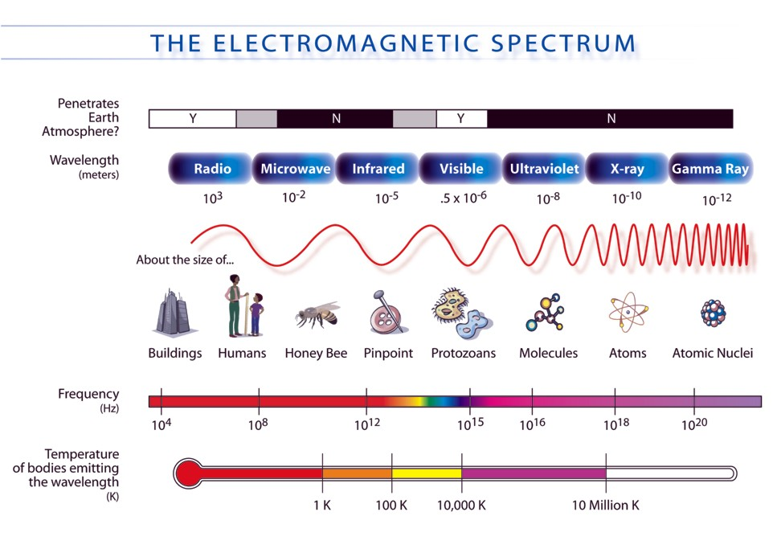
Background

Slide 6
Background
Different parts of the electromagnetic frequency spectrum can be used for data transmission depending on
The medium used
The communications standards followed
The properties of the media being used affect
Bandwidth, attenuation, noise, distortion

Slide 7
Background
Bandwidth – range of frequencies occupied or used by a carrier wave
Attenuation – strength of signal decreases as it propagates
Noise – unwanted electromagnetic energy that degrades the signal (crosstalk, background interference)
Distortion – altering the original shape or characteristics of waveform

Slide 8
Types of Signals: Analog & Digital
The two basic types of signals
1) Analog
2) Digital

Slide 9
Analog Signals
Characterized by data whose value varies over a continuous range
Temperature values at a certain location can assume an infinite number of values over time
Examples of analog data
Video
Audio
Historically telephony networks

Slide 10
Digital Signals
Characterized by data whose value is limited to a finite set of values
Examples of digital data
Text: printed English language (26 letters, 10 numbers, space, and punctuation)
Morse code (binary example – either a dot or a dash)

Slide 11
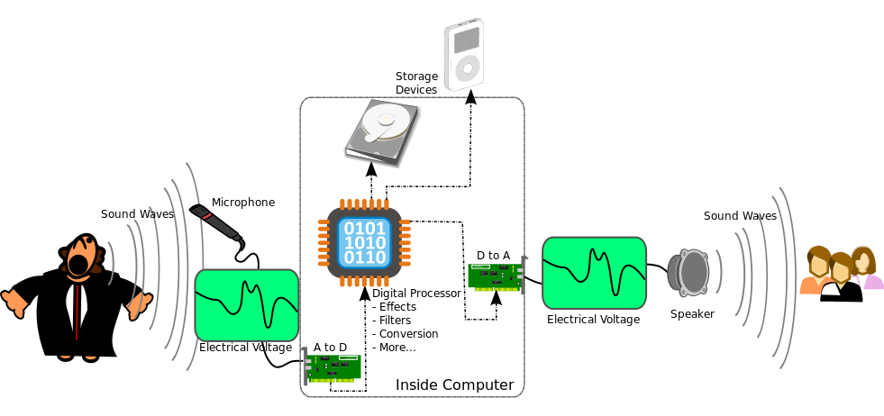
Types of signals
Source: http://upload.wikimedia.org/wikipedia/commons/thumb/8/84/A-D-A_Flow.svg/981px-A-D-A_Flow.svg.png

Slide 12
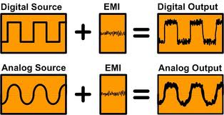
Analog versus digital
How does EMI impact each type of signal?

Slide 13
Analog Signals
Analog signals can be represented by a waveform diagram
Electromagnetic waves have four properties that are all important with respect to transmitting signals
1) Amplitude
2) Frequency
3) Wavelength
4) Phase

Slide 14
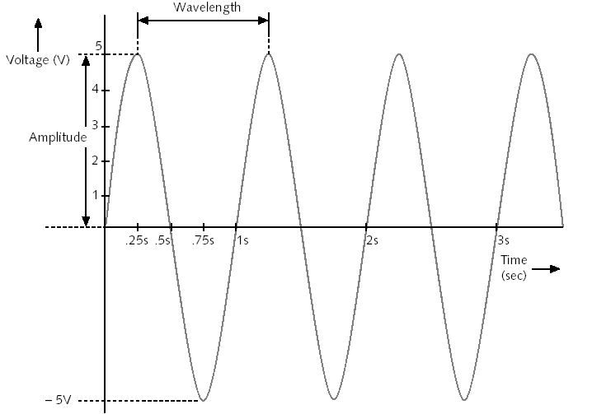
Electromagnetic Waveform Diagram

Slide 15
Electromagnetic waveform
Amplitude – A measure of waveform strength at a given point in time
Amplitude at 0.25 sec = 5 volts
Amplitude at 0.5 sec = 0
Amplitude at 0.75 sec = -5 volts

Slide 16
Electromagnetic waveform
Frequency - # of times a wave cycles from high amplitude to low amplitude and back again measured in cycles/sec (Hertz, Hz)
Frequency = 1 cycle / sec = 1 Hz
1 MHz cable can transfer (10⁶) or 1,000,000 wave cycles of current in 1 sec (wave peak to wave peak)
100 MHz can transfer 100,000,000 wave cycles / sec

Slide 17
Electromagnetic waveform
Wavelength – the distance between corresponding points on a wave cycle
Wavelength is generally expressed in some variant of meters or feet
Wavelength is inversely proportional to frequency - high frequency implies short wavelength

Slide 18
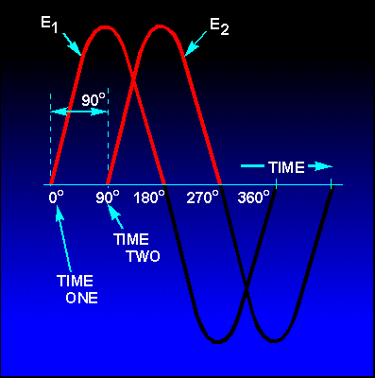
Electromagnetic waveform
Phase – the progress of a wave over time in relationship to a fixed point
Example: two separate waves with same amplitude and frequency starting at different points in time
Phases are 90 degrees apart
Often hear phase difference or phase offset discussed

Slide 19
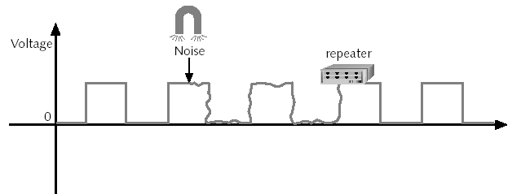
Analog versus digital
Digital signals can be regenerated using repeaters and active hubs
Cleaned up to prevent the accumulation of noise and distortion
Allows signal to be transmitted over greater distances

Slide 20
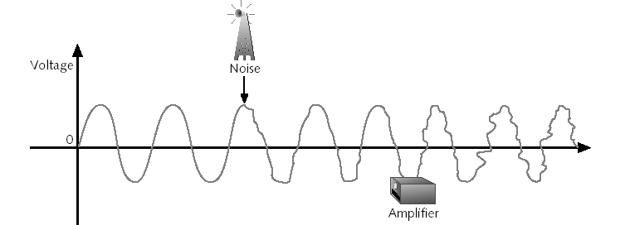
Analog versus digital
What happens to analog signals over distances even if they are amplified? Can you reconstruct the original signal?

Slide 21
Analog versus digital
Analog: one-to-one relationship between how data are captured and recorded and how data are reproduced
For example: microphone and speaker
Capture sound as a stream of electrical fluctuations → pass through an amplifier → to speaker (no alteration)
Source: http://www.informit.com/library/content.aspx?b=Planet_Broadband&seqNum=14

Slide 22
Analog versus digital
Digital: Reproduces text, pictures, sound, etc by sampling original output as high speed and assigning numeric code to represent the original (1s and 0s)
Pass code through network to analog converter that turns code back into electrical fluctuations
Source: http://www.informit.com/library/content.aspx?b=Planet_Broadband&seqNum=14

Slide 23
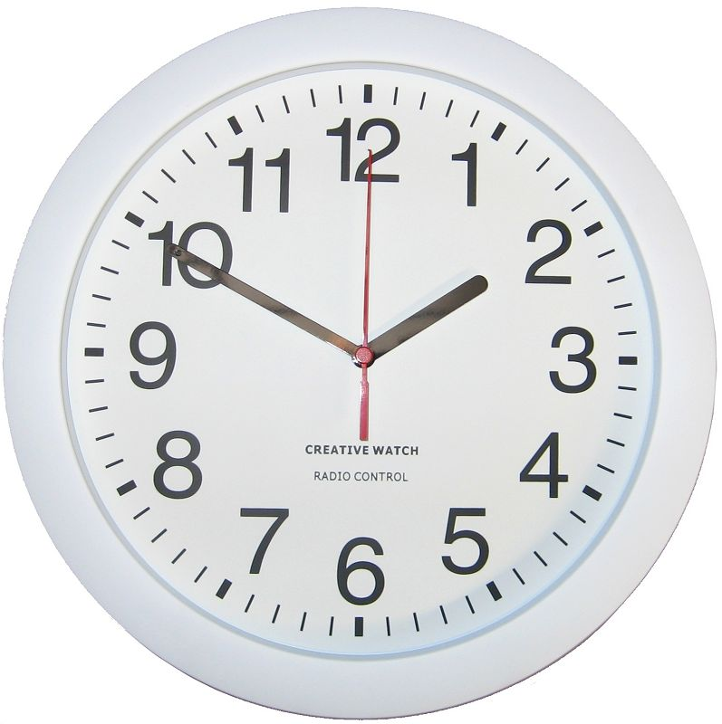
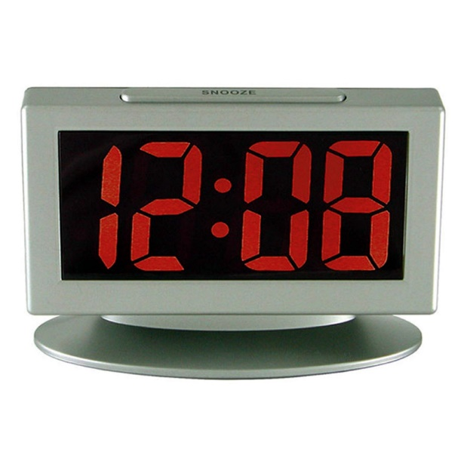
Clock Example
Analog clock – position of the hands on the clock corresponds to the time of day
Digital clock – the time of day is represented as a discrete set of numeric values
Based on SP Bali (2005), “2000 Solved Problems in Digital Electronics”

Slide 24
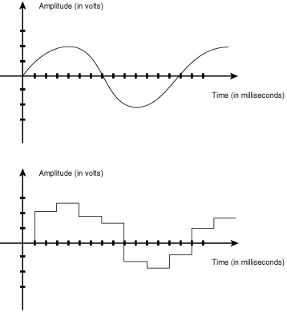
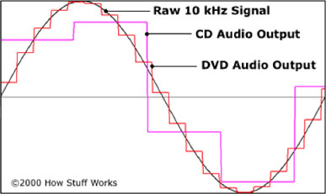
Analog to digital conversion

Slide 25
Data / signal combinations
Digital signals represent data with sequence of voltage pulses
Digital data / digital signal
Analog data / digital signal
Analog signals represent data with continuously varying electromagnetic wave
Digital data / analog signal
Analog data / analog signal
Source: Tseng, http://www.cs.sunysb.edu/~jgao/CSE370-spring06/lecture2.pdf

Slide 26
Data / signal combinations
Different types of data may be digital or analog by nature
Different types of networks use different types of signals
A wired LAN using Ethernet uses baseband, digital signaling
A WiFi LAN uses broadband, analog signaling
Potential benefits and drawbacks associated with different types of signals

Slide 27
Analog to digital conversion
Convert commonly occurring analog data / information such as voice and video to digital data for transmission over a either analog/digital network
We can transmit digital data
Faster
Cheaper
With fewer errors

Slide 28
Advantages of Digital Signals
Digital circuits have only two states so:
Changes in value have little effect on digital signals
Noise and other forms of interference have little effect on digital signals
Little chance of error because voltage in a digital circuit must be in one state or the other
Information storage is easy
Based on SP Bali (2005), “2000 Solved Problems in Digital Electronics”

Slide 29
Advantages of Digital Signals
Operation can be readily programed
Can fabricate more digital circuitry onto integrated circuits
Based on SP Bali (2005), “2000 Solved Problems in Digital Electronics”

Slide 30
Disadvantages of Digital Signals
The ONE major disadvantage is that the real-world is analog in nature
When dealing with analog inputs and outputs you will always have to: 1) convert analog to digital (ADC), 2) process the digital data, 3) convert the digital data back to analog output (DAC)
Based on SP Bali (2005), “2000 Solved Problems in Digital Electronics”

Slide 31
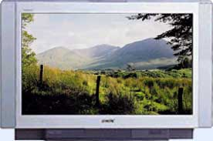


Digital Networks
Digital transmission enables networks to support many services
E-mail
TV
Telephone

Slide 32
Questions of Interest
How long will it take to transmit a message?
How many bits are in the message (text, image)?
How fast does the network/system transfer information?
Can a network/system handle a voice (video) call?
How many bits/second does voice/video require? At what quality?
How long will it take to transmit a message without errors?
How are errors introduced?
How are errors detected and corrected?
What transmission speed is possible over radio, copper cables, fiber, infrared, …?

Slide 33
Data Representation-Bits, numbers, information
Bit: number with value 0 or 1
n bits: digital representation for 0, 1, … , 2^{n}
Byte or Octet, n = 8
Computer word, n = 16, 32, or 64
n bits allows enumeration of 2^{n} possibilities
n-bit field in a header
n-bit representation of a voice sample
Message consisting of n bits
The number of bits required to represent a message is a measure of its information content
More bits → More content

Slide 34
Block vs. Stream Information
Block
Information that occurs in a single block
Text message
Data file
JPEG image
MPEG file
Size = bits / block
or bytes/block
1 Kbyte = 2¹⁰ bytes
1 Mbyte = 2²⁰ bytes
1 Gbyte = 2³⁰ bytes
Stream
Information that is produced & transmitted continuously
Real-time voice
Streaming video
Bit rate = bits / second
1 Kbps = 10³ bps
1 Mbps = 10⁶ bps
1 Gbps = 10⁹ bps

Slide 35
Transmission Delay
L number of bits in message
R bps speed of digital transmission system
L/R time to transmit the information
d distance in meters
c speed of light (3x10⁸ m/s in vacuum)
t_{prop} time for signal to propagate across medium
Delay = t_{prop} + L/R = d/c + L/R seconds
What can be done to reduce the delay?
Use data compression to reduce L
Use higher-speed modem to increase R
Place server closer to reduce d

Slide 36
Compression
Information usually not represented efficiently
Data compression algorithms
Represent the information using fewer bits
Noiseless: original information recovered exactly
e.g., zip, compress, GIF, fax
Noisy: recover information approximately
JPEG
Tradeoff: # bits vs. quality
Compression Ratio
#bits (original file) / #bits (compressed file)

Slide 37
Color Image
W
W
W
W
Color image
Red component image
Green component image
Blue component image
H
=
H
+
H
+
H
Total bits = 3 × H × W pixels × B bits/pixel = 3HWB bits
Example: 8×10 inch picture at 400 × 400 pixels per inch²
400 × 400 × 8 × 10 = 12.8 million pixels
8 bits/pixel/color
12.8 megapixels × 3 bytes/pixel = 38.4 megabytes

Slide 38
Examples of Block Information
Type | Method | Format | Original | Compressed(Ratio)
Text | Zip, compress | ASCII | Kbytes- Mbytes | (2-6)
Fax | CCITT Group 3 | A4 page 200x100 pixels/in² | 256 Kbytes | 5-54 Kbytes (5-50)
Color Image | JPEG | 8x10 in² photo 400² pixels/in² | 38.4 Mbytes | 1-8 Mbytes (5-30)

Slide 39
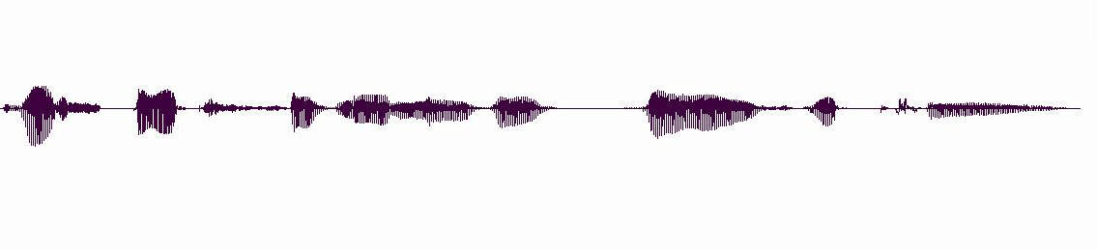
Stream Information
A real-time voice signal must be digitized & transmitted as it is produced
Analog signal level varies continuously in time
Th e s p ee ch s i g n al l e v el v a r ie s w i th t i m(e)

Slide 40
Digitization of Analog Signal
Sample analog signal in time and amplitude
Find closest approximation
Original signal
Sample value
7Δ/2
Approximation
5Δ/2
3Δ/2
Δ/2
3 bits / sample
−Δ/2
−3Δ/2
−5Δ/2
−7Δ/2
R_{s} = Bit rate = # bits/sample x # samples/second

Slide 41
Bit Rate of Digitized Signal
Bandwidth W_{s} Hertz: how fast the signal changes
Higher bandwidth → more frequent samples
Minimum sampling rate = 2 x W_{s}
Representation accuracy: range of approximation error
Higher accuracy
→ smaller spacing between approximation values
→ more bits per sample

Slide 42
Example: Voice & Audio
Telephone voice
W_{s} = 4 kHz → 8000 samples/sec
8 bits/sample
R_{s}=8 x 8000 = 64 kbps
Cellular phones use more powerful compression algorithms: 8-12 kbps
CD Audio
W_{s} = 22 kHz → 44000 samples/sec
16 bits/sample
R_{s}=16 x 44000= 704 kbps per audio channel
MP3 uses more powerful compression algorithms: 50 kbps per audio channel

Slide 43
Video Signal
Sequence of picture frames
Each picture digitized & compressed
Frame repetition rate
10-30-60 frames/second depending on quality
Frame resolution
Small frames for videoconferencing
Standard frames for conventional broadcast TV
HDTV frames
30 fps
Rate = M bits/pixel x (W x H) pixels/frame x F frames/second

Slide 44
Video Frames
176
QCIF videoconferencing
(144 lines and 176 pixels per line )
144
at 30 frames/sec =
760,000 pixels/sec
720
Broadcast TV
at 30 frames/sec =
10.4 x 10⁶ pixels/sec
480
1920
HDTV
at 30 frames/sec =
67 x 10⁶ pixels/sec
1080

Slide 45
Digital Video Signals
Type | Method | Format | Original | Compressed
Video Confer-ence | H.261 | 176x144 or 352x288 pix @10-30 fr/sec | 2-36 Mbps | 64-1544 kbps
Full Motion | MPEG2 | 720x480 pix @30 fr/sec | 249 Mbps | 2-6 Mbps
HDTV | MPEG2 | 1920x1080 pix @30 fr/sec | 1.6 Gbps | 19-38 Mbps

Slide 46
Transmission of Stream Information
Constant bit-rate
Signals such as digitized telephone voice produce a steady stream: e.g., 64 kbps
Network must support steady transfer of signal, e.g., 64 kbps circuit
Variable bit-rate
Signals such as digitized video produce a stream that varies in bit rate, e.g., according to motion and detail in a scene
Network must support variable transfer rate of signal, e.g., packet switching or rate-smoothing with constant bit-rate circuit

Slide 47
Stream Service Quality Issues
Network Transmission Impairments
Delay: Is information delivered in timely fashion?
Jitter: Is information delivered in sufficiently smooth fashion?
Loss: Is information delivered without loss? If loss occurs, is delivered signal quality acceptable?
Applications & application layer protocols developed to deal with these impairments

Slide 48
A Transmission System
Transmitter
Receiver
Communication channel
Transmitter
Converts information into signal suitable for transmission
Injects energy into communications medium or channel
Telephone converts voice into electric current
Modem converts bits into tones
Receiver
Receives energy from medium
Converts received signal into form suitable for delivery to user
Telephone converts current into voice
Modem converts tones into bits

Slide 49
Transmission Impairments
Transmitter
Transmitted Signal
Received Signal
Receiver
Communication channel
Communication Channel
Pair of copper wires
Coaxial cable
Radio
Light in optical fiber
Light in air
Infrared
Transmission Impairments
Signal attenuation
Signal distortion
Spurious noise
Interference from other signals

Slide 50
Analog Long-Distance Communications
Transmission segment
Source
Repeater
. . .
Repeater
Destination
Each repeater attempts to restore analog signal to its original form
Restoration is imperfect
Distortion is not completely eliminated
Noise & interference is only partially removed
Signal quality decreases with # of repeaters
Communications is distance-limited
Still used in analog cable TV systems
Analogy: Copy a song using a cassette recorder

Slide 51
Analog vs. Digital Transmission
Analog transmission: all details must be reproduced accurately
Distortion
Attenuation
Sent
Received
Digital transmission: only discrete levels need to be reproduced
Sent
Distortion
Attenuation
Received
Simple Receiver: Was original pulse positive or negative?

Slide 52
Digital Long-Distance Communications
Transmission segment
Source
Regenerator
. . .
Regenerator
Destination
Regenerator recovers original data sequence and retransmits on next segment
Can design it so error probability is very small
Then each regeneration is like the first time!
Analogy: copy an MP3 file
Communications is possible over very long distances
Digital systems vs. analog systems
Less power, longer distances, lower system cost
Monitoring, multiplexing, coding, encryption, protocols…

Slide 53
Digital Binary Signal
1
0
1
1
0
1
+A
0
T
2T
3T
4T
5T
6T
-A
Bit rate = 1 bit / T seconds
For a given communications medium:
How do we increase transmission speed?
How do we achieve reliable communications?
Are there limits to speed and reliability?

Slide 54
Pulse Transmission Rate
Objective: Maximize pulse rate through a channel, that is, make T as small as possible
Channel
T
t
t
If input is a narrow pulse, then typical output is a spread-out pulse with ringing
Question: How frequently can these pulses be transmitted without interfering with each other?
Answer: 2 x W_{c} pulses/second
where W_{c} is the bandwidth of the channel

Slide 55
Multilevel Pulse Transmission
Assume channel of bandwidth W_{c}, and transmit 2 W_{c} pulses/sec (without interference)
If pulses amplitudes are either -A or +A, then each pulse conveys 1 bit, so
Bit Rate = 1 bit/pulse x 2W_{c} pulses/sec = 2W_{c} bps
If amplitudes are from {-A, -A/3, +A/3, +A}, then bit rate is 2 x 2W_{c} bps
By going to M = 2^{m} amplitude levels, we achieve
Bit Rate = m bits/pulse x 2W_{c} pulses/sec = 2mW_{c} bps
In the absence of noise, the bit rate can be increased without limit by increasing m

Slide 56
Noise & Reliable Communications
All physical systems have noise
Electrons always vibrate at non-zero temperature
Motion of electrons induces noise
Presence of noise limits accuracy of measurement of received signal amplitude
Errors occur if signal separation is comparable to noise level
Bit Error Rate (BER) increases with decreasing signal-to-noise ratio
Noise places a limit on how many amplitude levels can be used in pulse transmission

Slide 57
Signal-to-Noise Ratio
Signal
Noise
Signal + noise
High
SNR
t
t
t
No errors
Signal
Noise
Signal + noise
Low
SNR
t
t
t
Average signal power
error
SNR =
Average noise power
SNR (dB) = 10 log₁₀ SNR

Slide 58
Shannon Channel Capacity
C = W_{c} log₂ (1 + SNR) bps
Arbitrarily reliable communications is possible if the transmission rate R < C.
If R > C, then arbitrarily reliable communications is not possible.
“Arbitrarily reliable” means the BER can be made arbitrarily small through sufficiently complex coding.
C can be used as a measure of how close a system design is to the best achievable performance.
Bandwidth W_{c} & SNR determine C

Slide 59
Example
Find the Shannon channel capacity for a telephone channel with W_{c} = 3400 Hz and SNR = 10000
C = 3400 log₂ (1 + 10000)
= 3400 log₁₀ (10001)/log₁₀2 = 45200 bps
Note that SNR = 10000 corresponds to
SNR (dB) = 10 log₁₀(10001) = 40 dB

Slide 60
Bit Rates of Digital Transmission Systems
System | Bit Rate | Observations
Telephone twisted pair | 33.6-56 kbps | 4 kHz telephone channel
Ethernet twisted pair | 10 Mbps, 100 Mbps, 1 Gbps | 100 meters of unshielded twisted copper wire pair
Cable modem | 500 kbps-4 Mbps | Shared CATV return channel
ADSL | 64-640 kbps in, 1.536-6.144 Mbps out | Coexists with analog telephone signal
2.4 GHz radio | 2-11 Mbps | IEEE 802.11 wireless LAN
28 GHz radio | 1.5-45 Mbps | 5 km multipoint radio
Optical fiber | 2.5-10 Gbps | 1 wavelength
Optical fiber | >1600 Gbps | Many wavelengths

Slide 61
Examples of Channels
Channel | Bandwidth | Bit Rates
Telephone voice channel | 3 kHz | 33 kbps
Copper pair | 1 MHz | 1-6 Mbps
Coaxial cable | 500 MHz (6 MHz channels) | 30 Mbps/ channel
5 GHz radio (IEEE 802.11) | 300 MHz (11 channels) | 54 Mbps / channel
Optical fiber | Many TeraHertz | 40 Gbps / wavelength

